Slide 1
Lecture 4 Conducting Reproducible Research
Dr Andy MacLachlan
Centre for Advanced Spatial Analysis
October 2023

Slide 2
Last week review
Deal with coordinate reference systems
List files in folders
Know how rasters are loaded
Able to extract data from rasters for analysis
Plot histograms

Slide 3
Some common Qs
Difference terra and raster
The terra documentation states “can do more, is simpler to use, and it is faster.”
Slight differences in sytax
Roger Bivand who maintained some key packages for raster has retired- rgdal (reading of data) and rgeos (geometry of the data ) = GIS in R….

Slide 4
Some common Qs
Who do we use largest share rule for raster / can we do it…
Yes…in terra::extract()
Argument exact = TRUE – give the % of each cell covered
Touches = TRUE…values for all cells touched by lines or polygons are extracted, not just those on the line render path, or whose center point is within the polygon. Not relevant for points; and always considered TRUE when weights=TRUE or exact=TRUE
Method = method for extracting values with points ("simple" or "bilinear"). With "simple" values for the cell a point falls in are returned. With "bilinear" the returned values are interpolated from the values of the four nearest raster cells
See: https://rdrr.io/cran/terra/man/extract.html

Slide 5
Some common Qs
Raster developments
stars package – works with sf and sf functions, not well documented
terra – works with files that can be stored on disc and not in RAM + makes classes – SpatRaster
There isn’t a clear raster winner at the moment

Slide 6
Some common Qs
The benefit of listing files
You can load them from the list you get – as opposed to reading them all in and then stacking
Account for any future file name changes

Slide 7
Some common Qs
Difference between sp (2005) and sf (2016)
intuitive data structures sp data, like the SpatialPolygonsDataframe were composed of lists inside lists and were quite hard to decompose (there was a good reason why it was coded like this, but I forget why).
sf objects are just data-frames that are collections of spatial objects. Each row is a spatial object (e.g. a polgyon), that may have data associated with it (e.g. its area) and a special geo variable that contains the coordinates.
https://www.r-bloggers.com/2018/03/should-i-learn-sf-or-sp-for-spatial-r-programming/
Easier to use sf with tidyverse

Slide 8
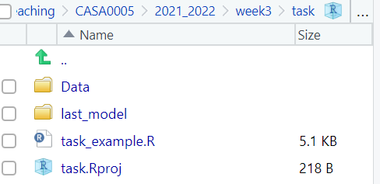
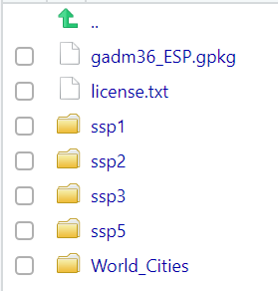
Some common Qs
The here package
Struggling to load data that is within your project folder?
Here starts at your project folder…so if data is in your project folder it’s just…
world_cities <- st_read(here( "World_cities.shp"))
Within a data folder and world_cities folder
world_cities <- st_read(here("Data", "World_Cities", "World_cities.shp"))

Slide 9
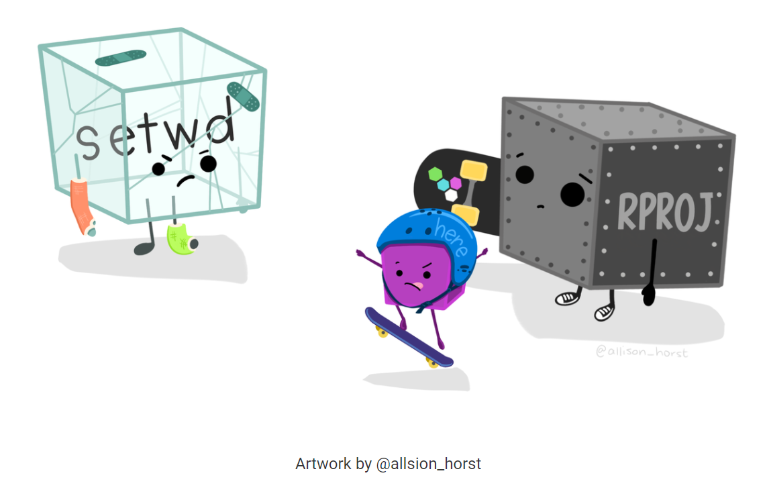
Some common Qs
Do not use setwd()!
Exam – we can’t reproduce.
Ideally don’t use file paths, use here – cross operating system compatible.
We can also use tab like I showed..
Comment your code with #

Slide 10
Have you used git and Github before
No
Both
Git
GitHub

Slide 11
But why
From rOpenSci
“The aim of practising reproducible computational research is to expose more of the research workflow to our audience. This makes it easier for them to make a more informed assessment of our methods and results, and makes it easier for them to adapt our methods to their own research.”
http://ropensci.github.io/reproducibility-guide/sections/introduction/

Slide 12
Everytime i read a paper / article / some research
Could easily do what they did
Probably do it with some work
I would need to make assumptions
It would take me a long time to work it out
No way

Slide 13
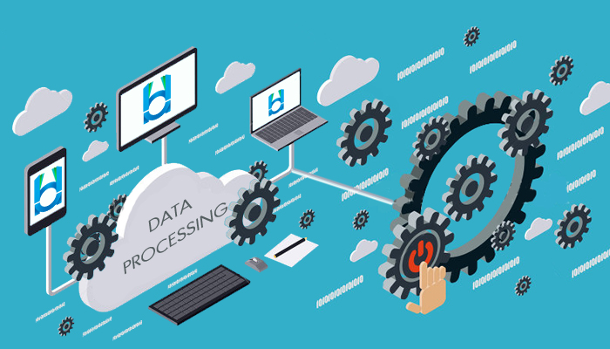


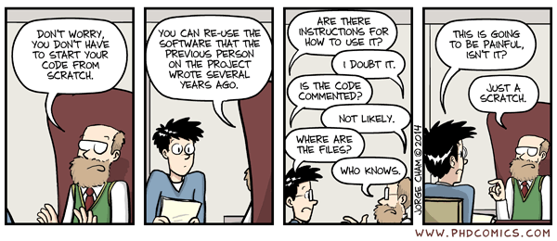
The past

Slide 14
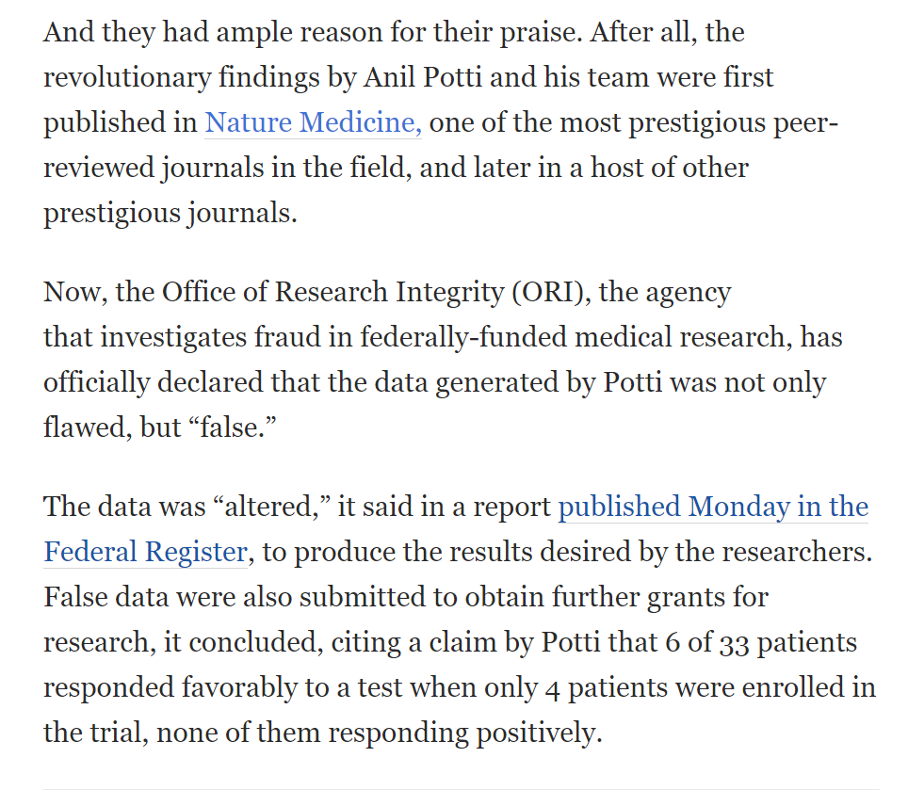
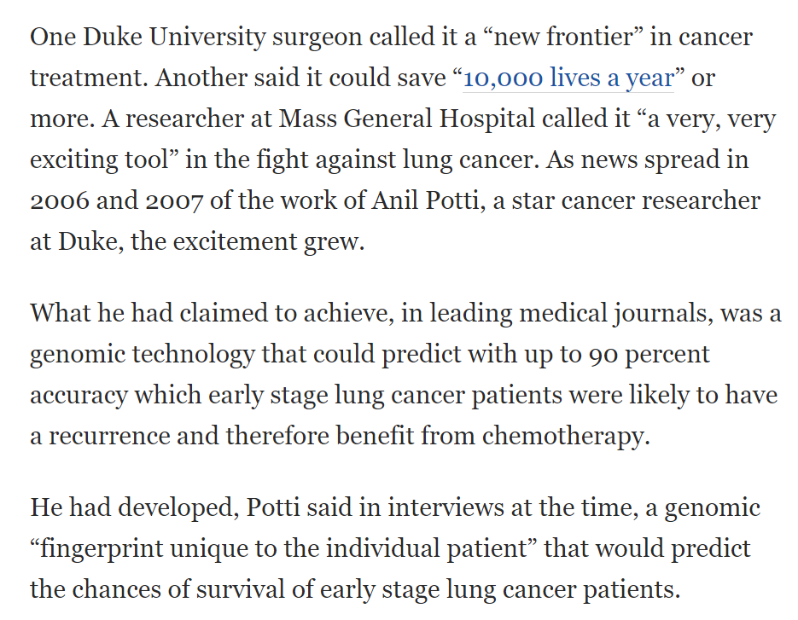
the Duke/Potti scandal
Source: the Washington post, see https://www.youtube.com/watch?v=7gYIs7uYbMo&t=328s

Slide 15


Slide 16

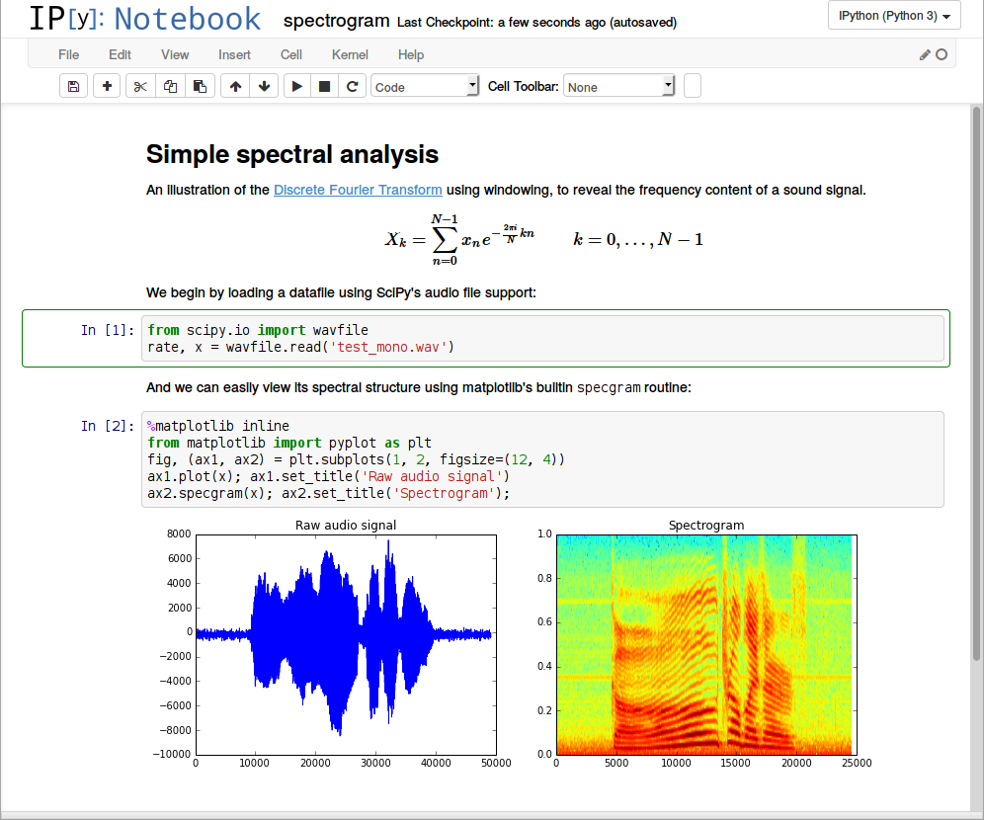
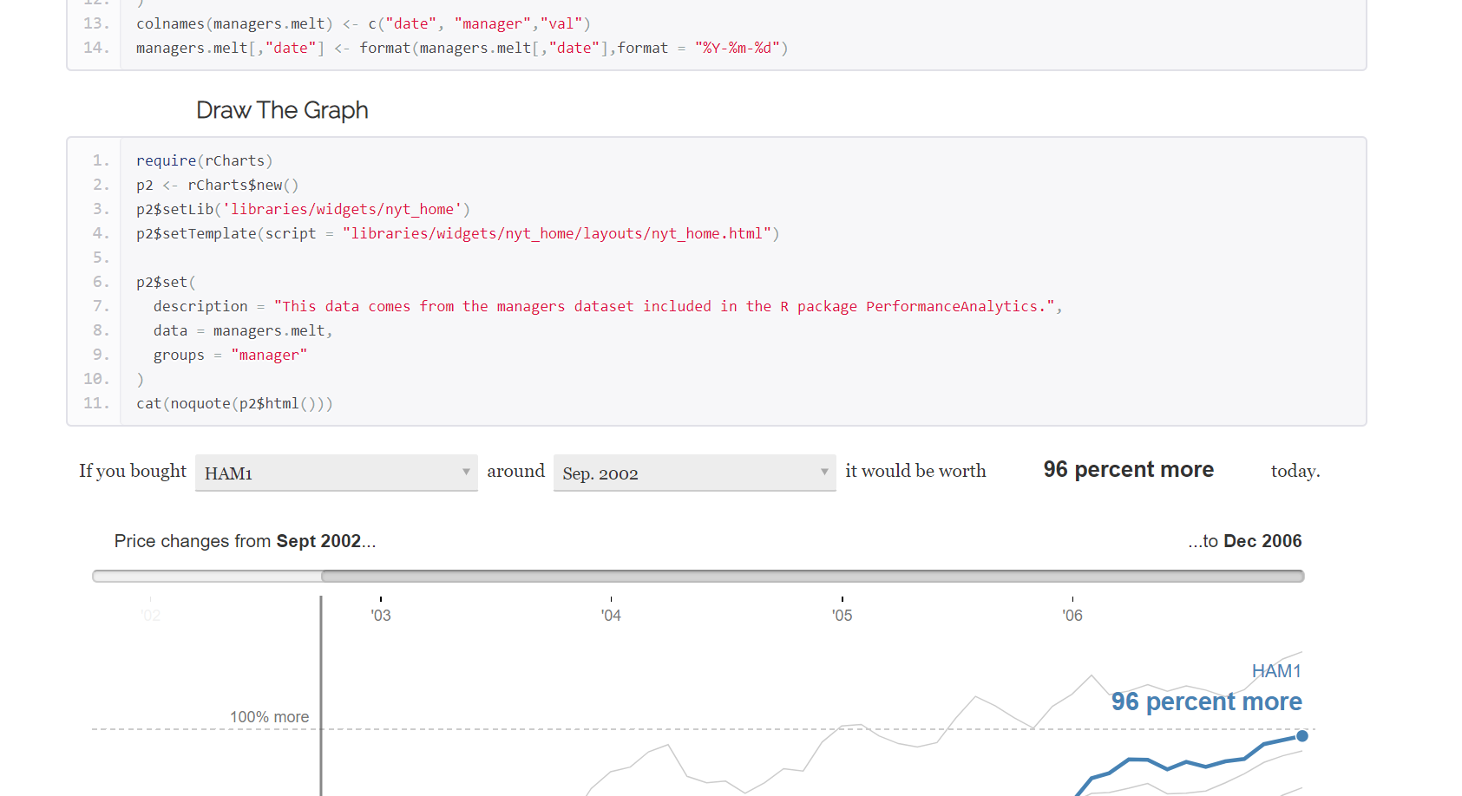
The future…

Slide 17
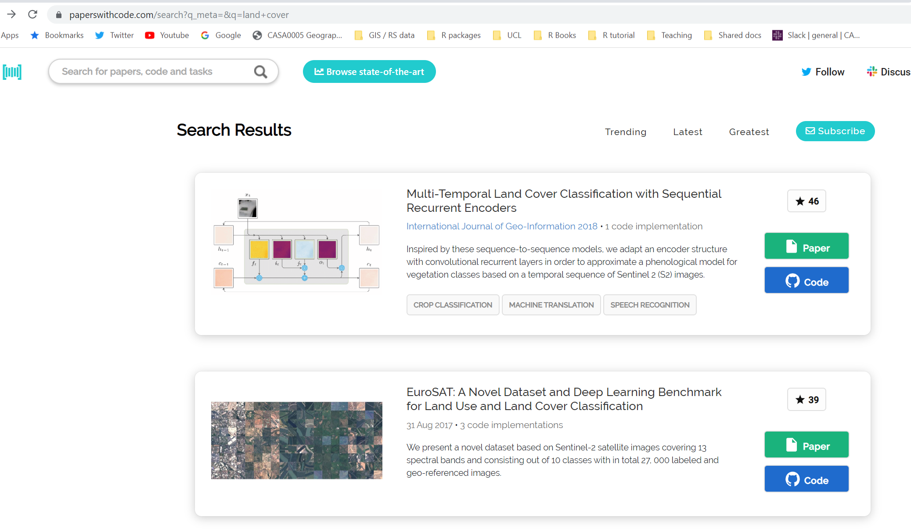
The future…it’s happening now..ish

Slide 18


BUT…
We have the most amount of data ever
Methodological procedures are expanding
Unreproducible results
Data is being weaponised and misrepresented
Data is being polluted
Fake news

Slide 19
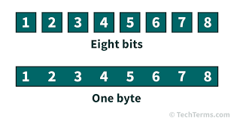
For 2017, 90% of the data in the world today has been created in the last two years alone, at 2.5 quintillion bytes of data a day! - IBM
Quintillion = a thousand raised to the power of six (1018)

Slide 20
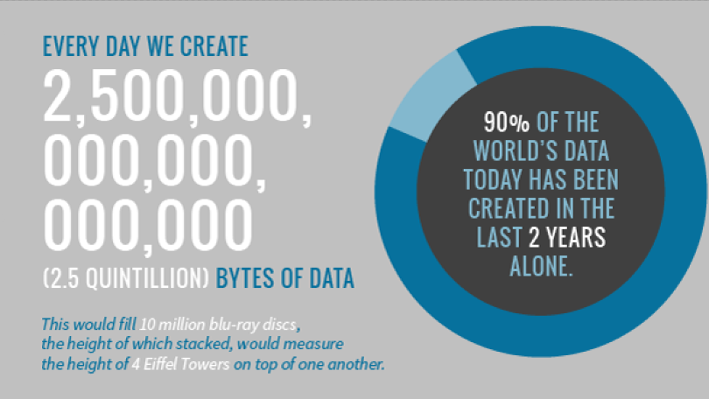

Slide 21
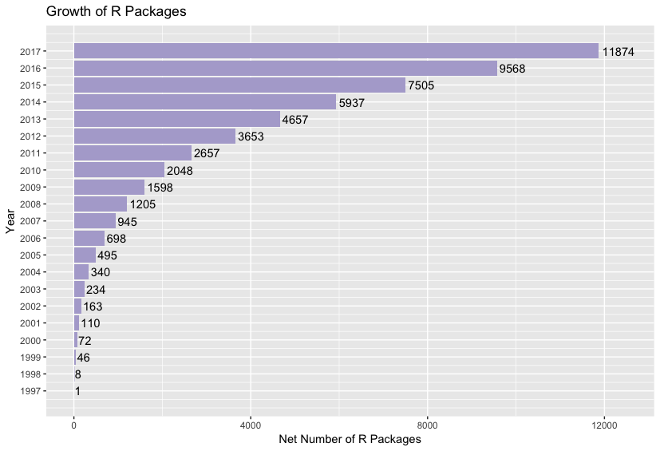

Slide 22
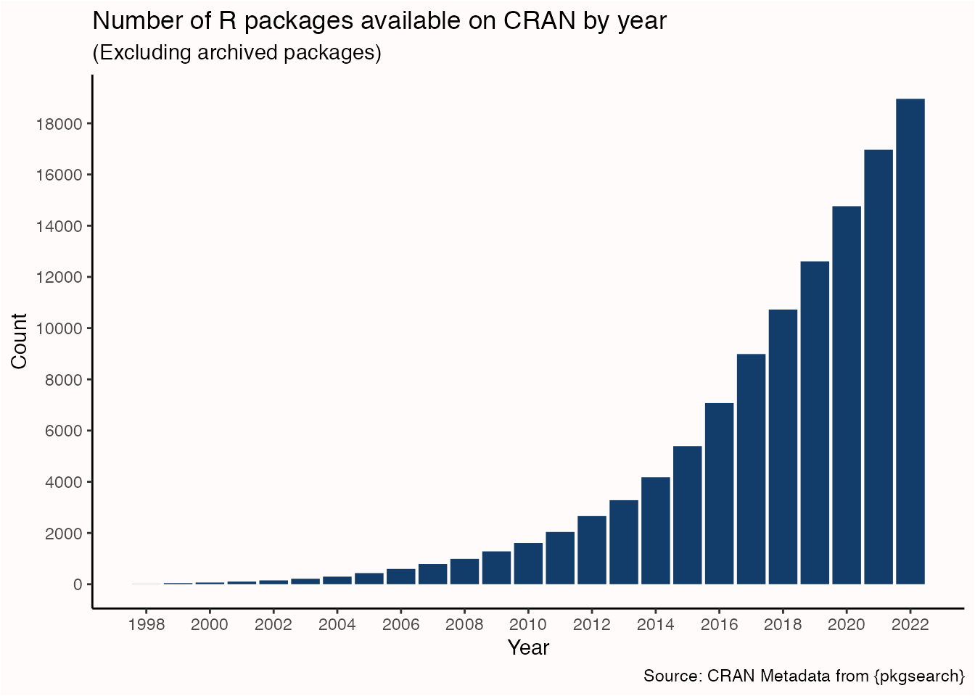
A more updated plot…

Slide 23
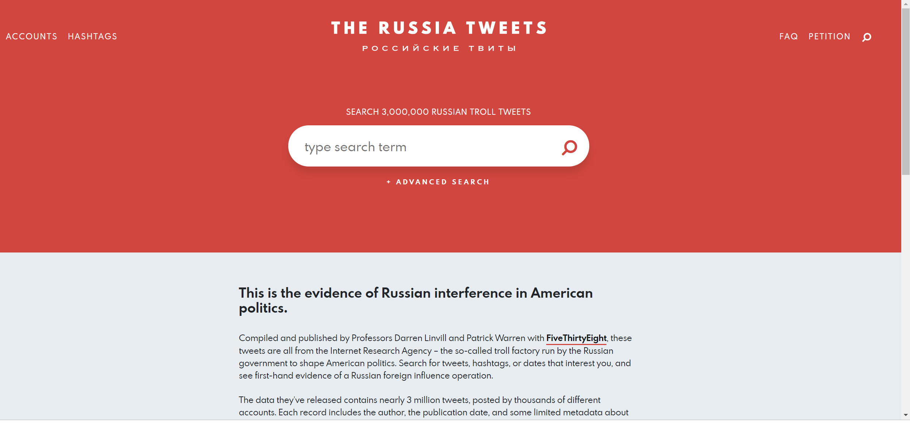
The Internet Research Agency’s influence operation seems to have had multiple goals (none of which was internet research). Its accounts amplified political voices on the far-Left and far-Right, making it seem as though Americans were much angrier and more polarized than they are. They promulgated reports of disasters that never happened. They pushed perspectives and news stories that favored the Russian government. Sometimes, they just tweeted out real news stories or played harmless games. Overall, the effect was to give the Russian government more control over social media, both within its own borders and around the world.

Slide 24
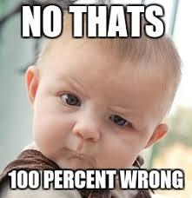
Amgen
Looked at 53 landmark cancer research studies
Findings only confirmed in 6 (11%)
Begley and Ellis (2012) Raise standards for preclinical cancer research, Nature

Slide 25
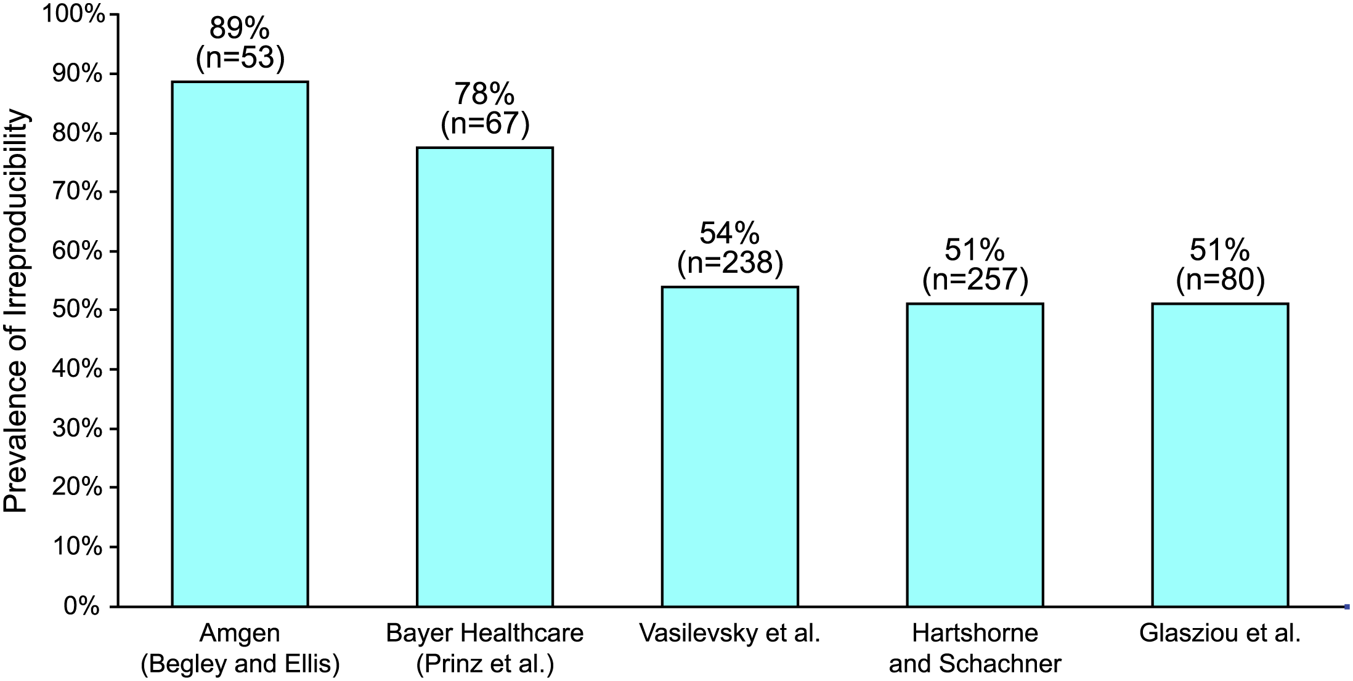
The Economics of Reproducibility in Preclinical Research
Irreproducible research > 50%
USD$ 28 billion spent on preclinical research that is not reproducible per year
Freedman et al. (2015) The Economics of Reproducibility in Preclinical Research, PLOS

Slide 26
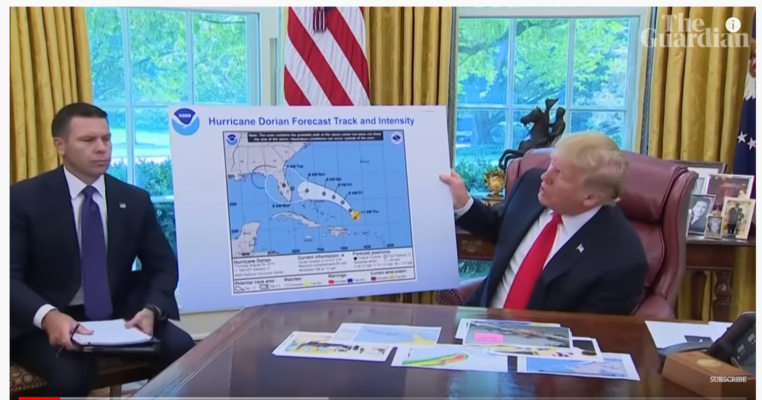
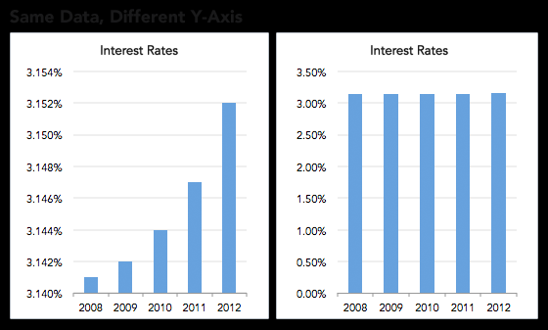

Fake news / reporting / trusted sources
"The UK has never sent, given or provided £350 million a week to Europe”
Data is being misrepresented
How reliable is the IPCC report

Slide 27
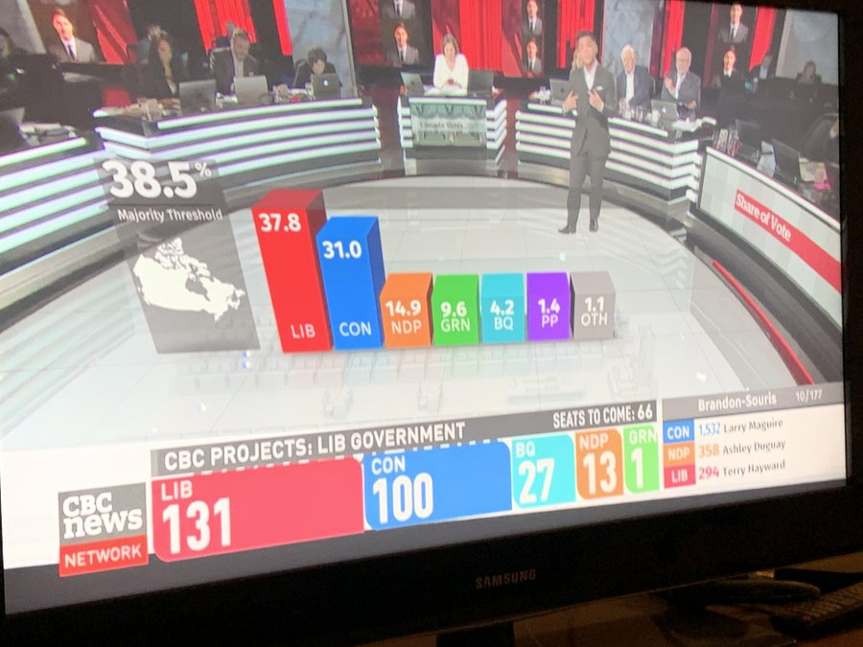
Fake news / reporting / trusted sources
What’s wrong with this from the last Canadian election

Slide 28
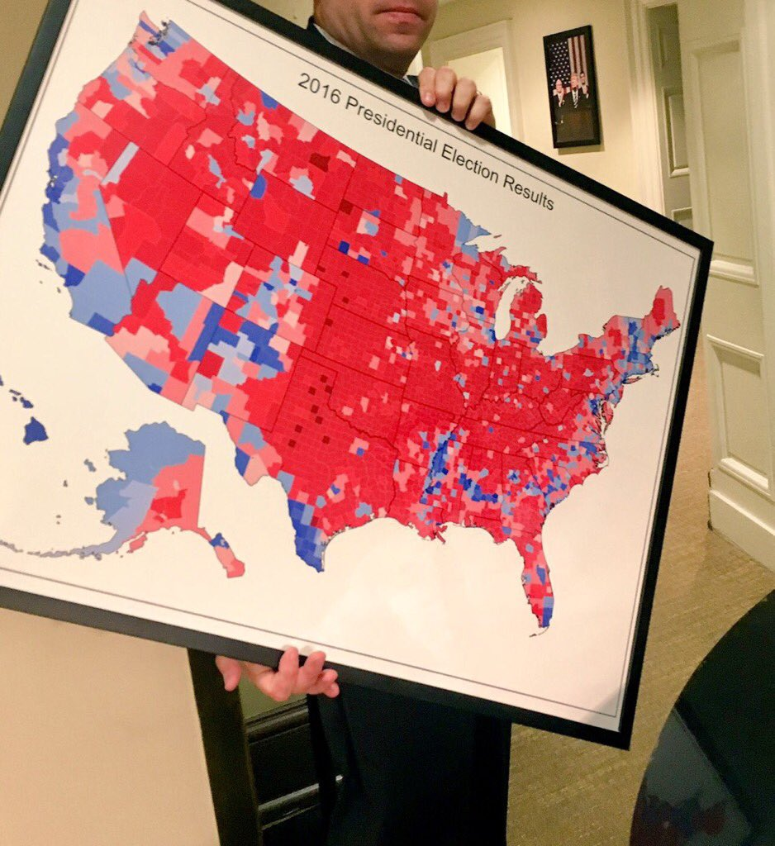
What’s wrong with this? (by county)

Slide 29
US electoral college
Polygon size does not equal population
Did all the people in each county vote for 1 party? NO.
Electoral college
Each state gets three votes
Remaining divided by population
BONUS to smaller states
1 vote in Wyoming = 193,000 people
1 vote in California = over 700,000 people
Democrats got more votes, but lost

Slide 30
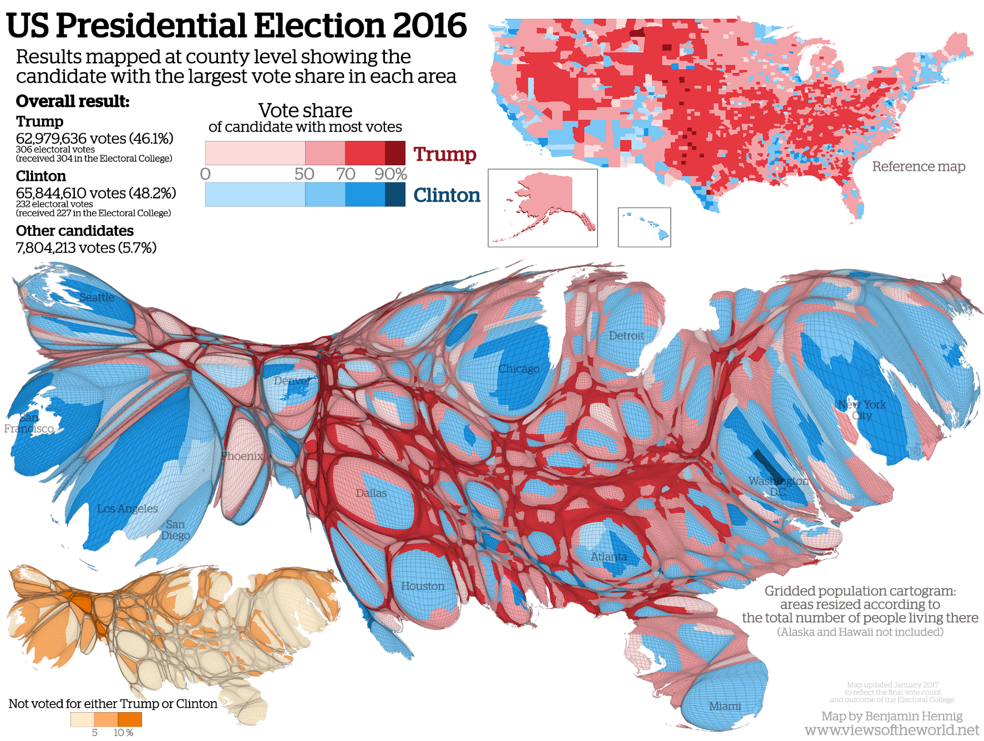
US electoral college

Slide 31
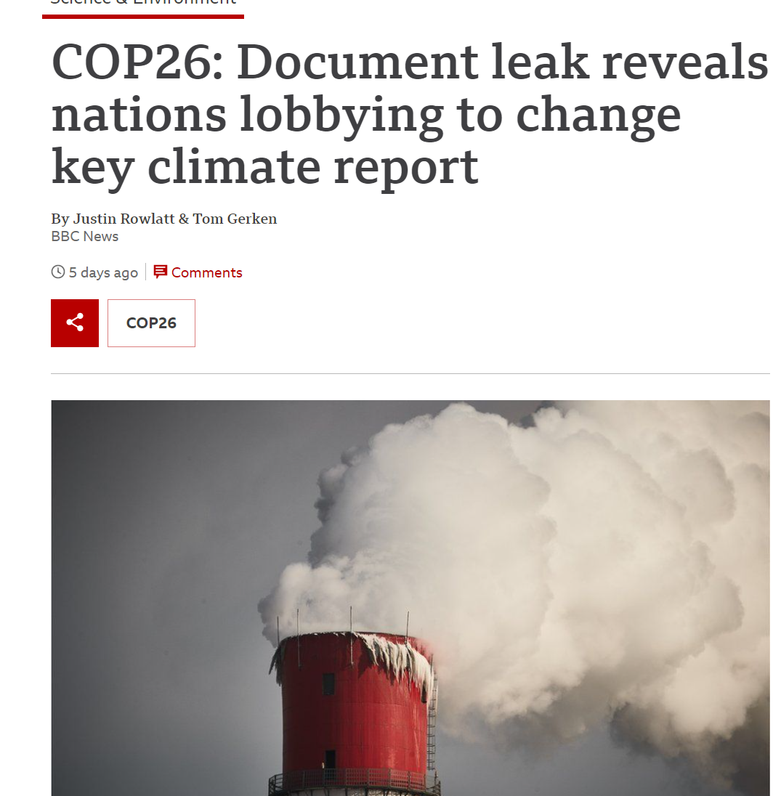
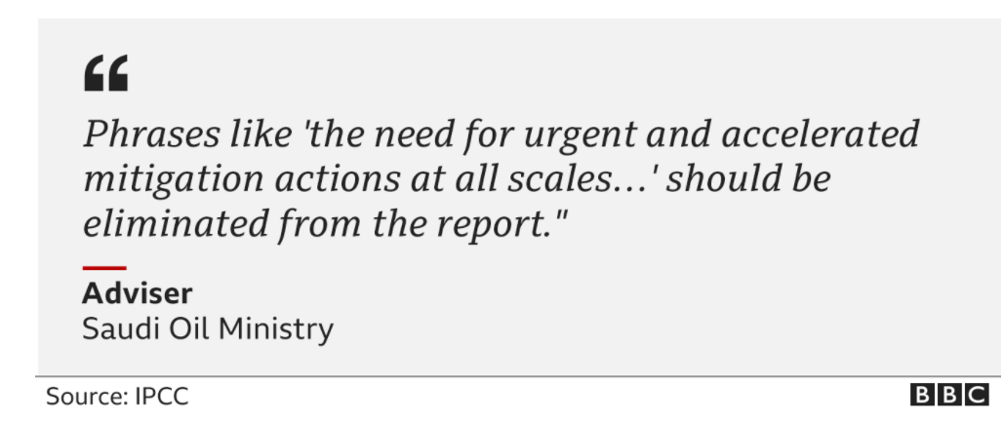
Hidden (or not so hidden) agendas
Government pressure
“One senior Australian government official rejects the conclusion that closing coal-fired power plants is necessary, even though ending the use of coal is one of the stated objectives the COP26 conference”

Slide 32

Fake news / reporting / trusted sources/ agendas
Mass of data
More methodological procedures
Data pollution
Low reproducibility
Misrepresentation of data potential

Slide 33
Conducting Reproducible Research
Guards against
Academic fraud
Erroneous interpretation
Allows for
Independent verification through transparency
Critique of methods
Critique of results
Promotes
New techniques
Good scientific practice

Slide 34
Conducting Reproducible Research
Decisions being made by AI? Data science? People? Bias? Unconscious bias?
BUT….
Where has the data come from
Who collected it and for what purpose
What was their agenda
Were the spatial areas representative of the population
Who wrote the software
What are the consequences of manipulating data or methods?

Slide 35
Conducting Reproducible Research
Be critical of the data, methods and outputs
This is part of the exam
Where has the data or boundaries we are using come from
What /who has influenced it? Can they be trusted?
Next slides will give a series of examples
Redlining
Gerrymandering

Slide 36
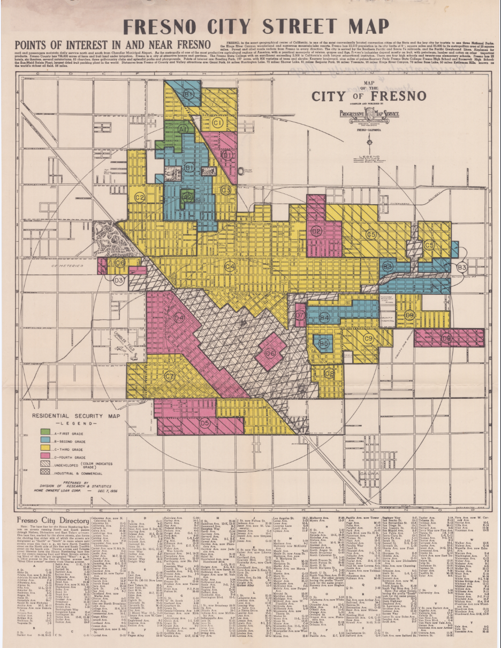
Conducting Reproducible Research – data bias?
Redlining
The New Deal after great depression
National housing act = 30 year mortgage
We don’t want them to miss payment…
1930s – American Home Owner’s Loan Corporation – prevent missed payments….residential security maps
Who was responsible for this? Mostly white, male panel – Detroit Chamber of Commerce and Federal Home Loan Bank board
Catherine D'Ignazio and Lauren Klein (2020)
https://www.youtube.com/watch?v=O5FBJyqfoLM

Slide 37
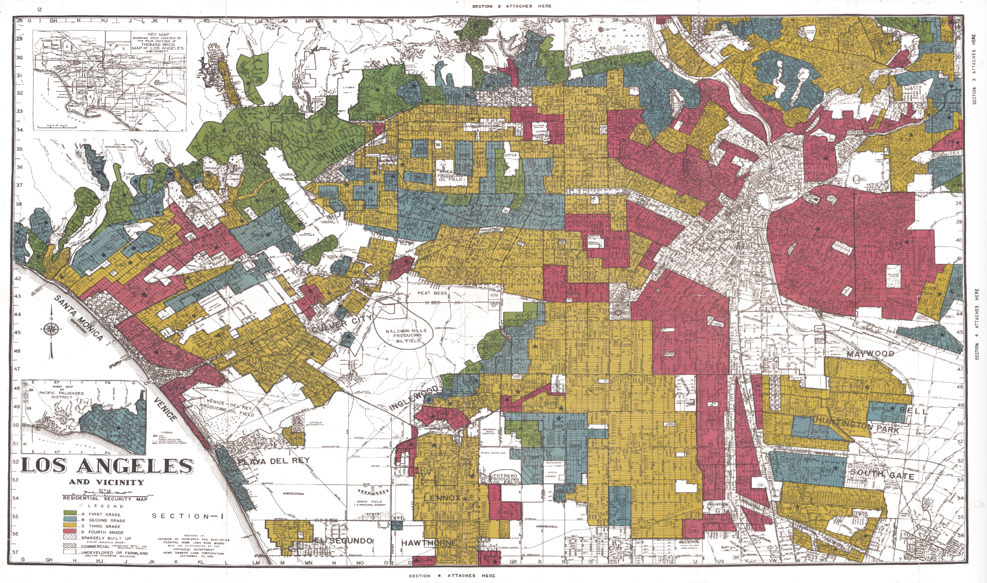
Conducting Reproducible Research – data bias?
Redlining
Green = business men
Blue = white collar
Yellow = working class, declining area
Red = detrimental, hazardous, race
Studies show that not more likely to default (miss payments)
People abandon the redlined areas…
Can’t refinance if you are already there.
Local property taxes pay for the schools….higher value = more school money
Spatial data on redlining: https://dsl.richmond.edu/panorama/redlining/#loc=5/39.1/-94.58&text=downloads

Slide 38
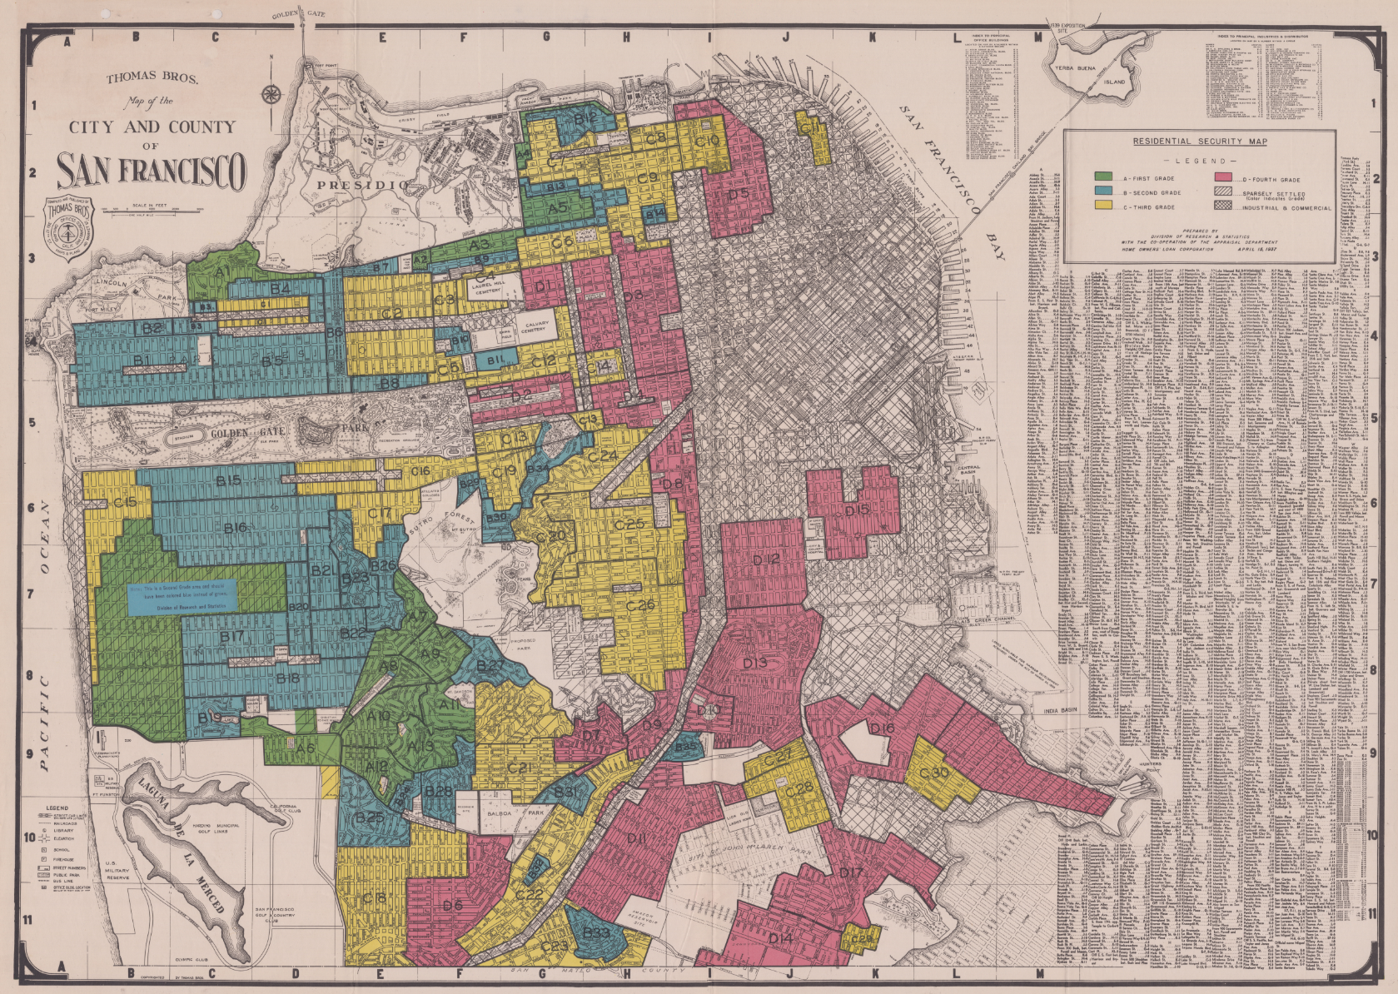
Conducting Reproducible Research – data bias?
Redlining
The Civil Rights Act of 1968 (the Fair Housing Act) made it unlawful to discriminate housing or financing in this manner.
Days after assassination of Martin Luther King
Selectively enforced…
Housing segregation
However, the redlining legacy has left severe social equity issues across cities, such as access to outdoor space, clean air, trees.
Other decisions make in a similar way (e.g. healthcare investments)

Slide 39
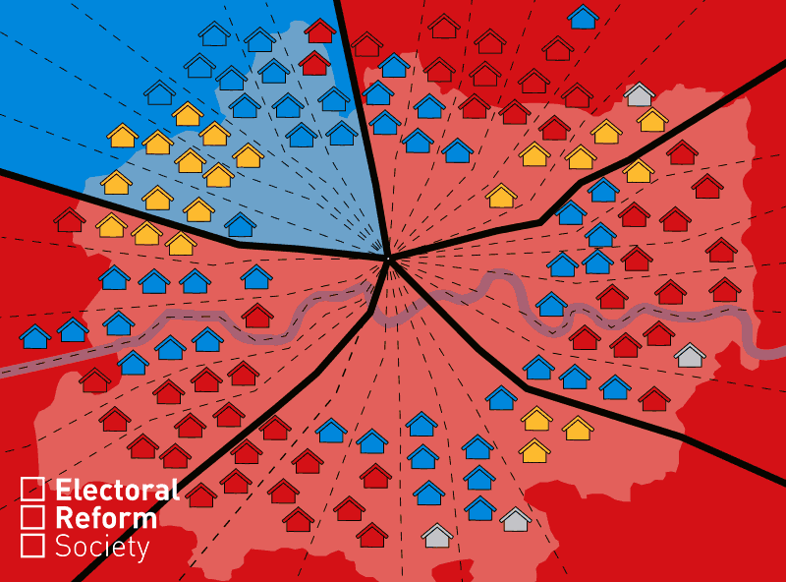
Conducting Reproducible Research – data bias?

Slide 40
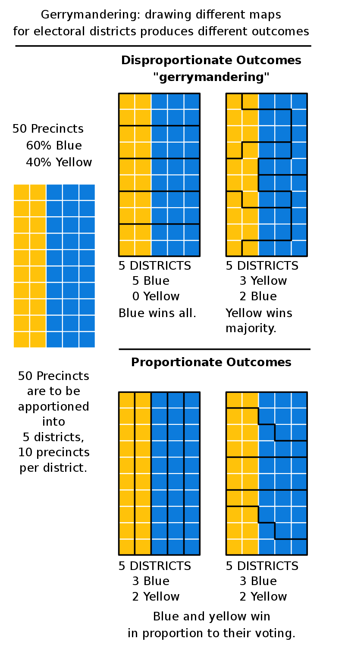
Conducting Reproducible Research – data bias?

Slide 41
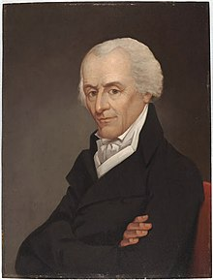
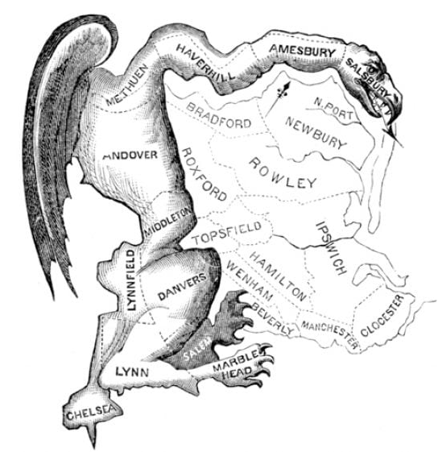
Conducting Reproducible Research – data bias?
Gerrymandering (1812)
Named after Elbridge Gerry (vice president)
redistricted Massachusetts for the benefit of the Democratic-Republican Party (1812 election)
Created partisian (party) district in Boston similar to the salamander

Slide 42
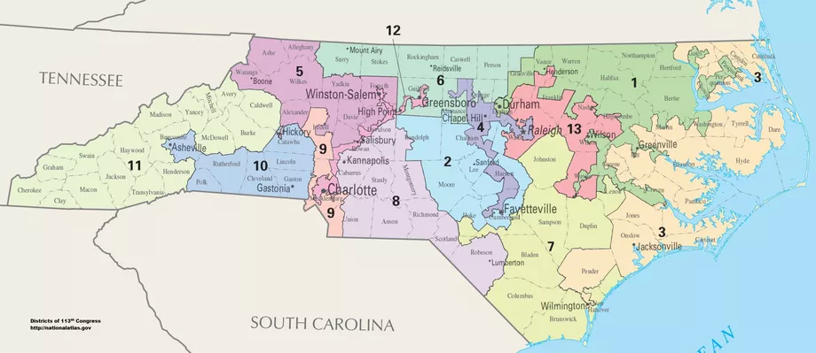
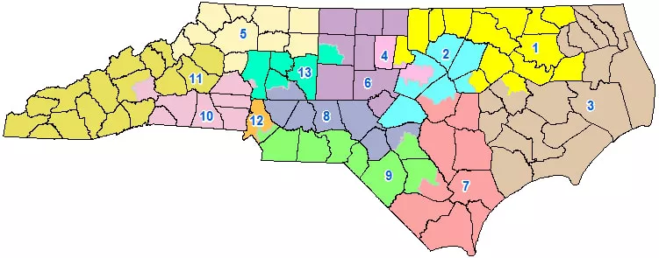
Conducting Reproducible Research – data bias?
Gerrymandering
Every 10 years electoral districts are re-drawn “redistricting”– Thomas Hofeller (republican) = PACK and CRACK
2011 redraw state congressional districts for North Carolina
District 12 – racial gerrymandering
Republicans took power + legislation = DANGER
Federal courts - 2016/2017 by republicans was racial gerrymandering. Redraw the lines without race. Looked at areas that voted for each part – partisan (party) gerrymandering – cracked Greensborough into 2 districts
In case 1 Greensborough (democrat) was packed (on race) in case 2 it was cracked (on party preference).
Multiple cases over 50% of voters for democrat BUT representation meant less than 50%. Congress = 48% of votes democrat to 23% seats
2019 – supreme court said it wasn’t their job. Left state to rule. Found it violated state constitution. Must redraw! Approve by legislators
Representatives are selecting voters! Not the other way around?
https://www.youtube.com/watch?v=KpamjJtXqFI

Slide 43
Conducting Reproducible Research – data bias?

Slide 44
Conducting Reproducible Research – data bias?
Gerrymandering
Racial division (packing of people)…to…
Partisan division (cracking of people)
2018 election
Congress = 48% of votes for 23% of seats
2019 violated state constitution

Slide 45
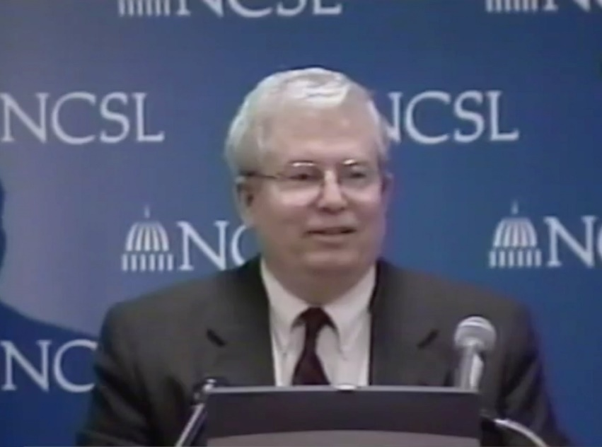
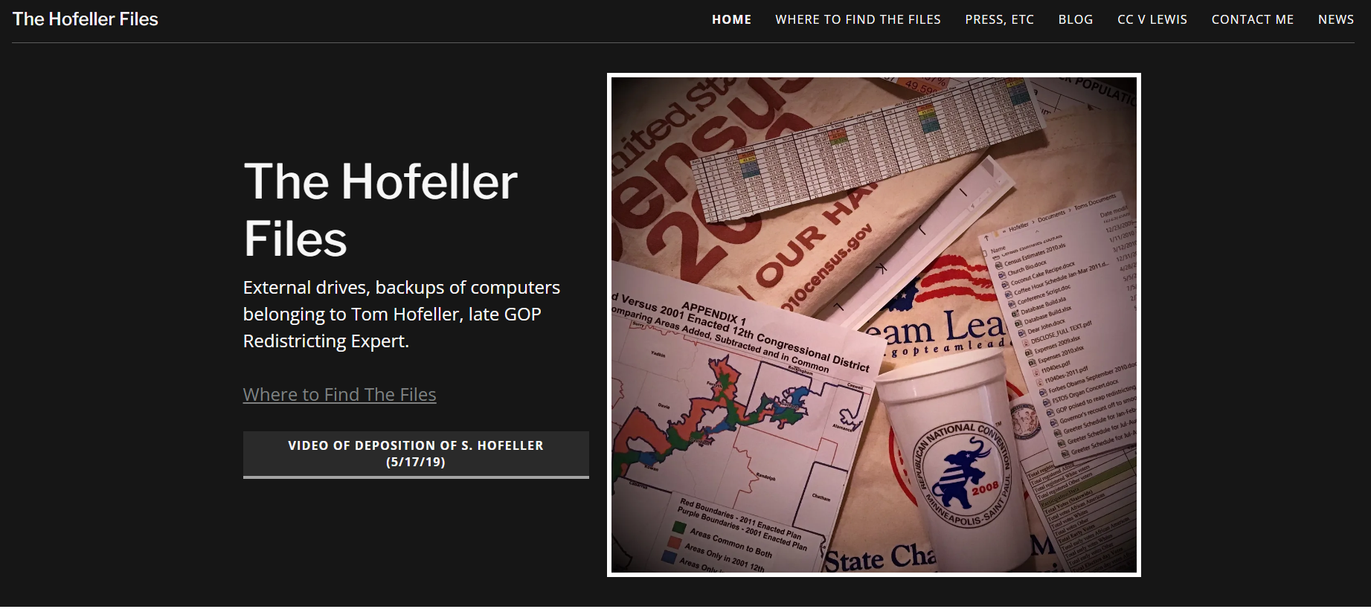
Conducting Reproducible Research – data bias?
Gerrymandering
“Restricting is democracy at work” – Tom Hofeller
Democracy: a system of government by the whole population or all the eligible members of a state, typically through elected representatives.

Slide 46
Conducting Reproducible Research - blackbox
“All of the implementations were tested with the same input data. They all gave the same results except the ESRI/ArcGIS implementation (Li 2018), and although ESRI provide help for the GWR tools, the actual coding is closed—the underlying code is not revealed” Brunsdon and Comber, 2020
Reproducible research isn’t just about the code we write or the analysis we do. The data we access is beyond our control but we must explore it critically.

Slide 47
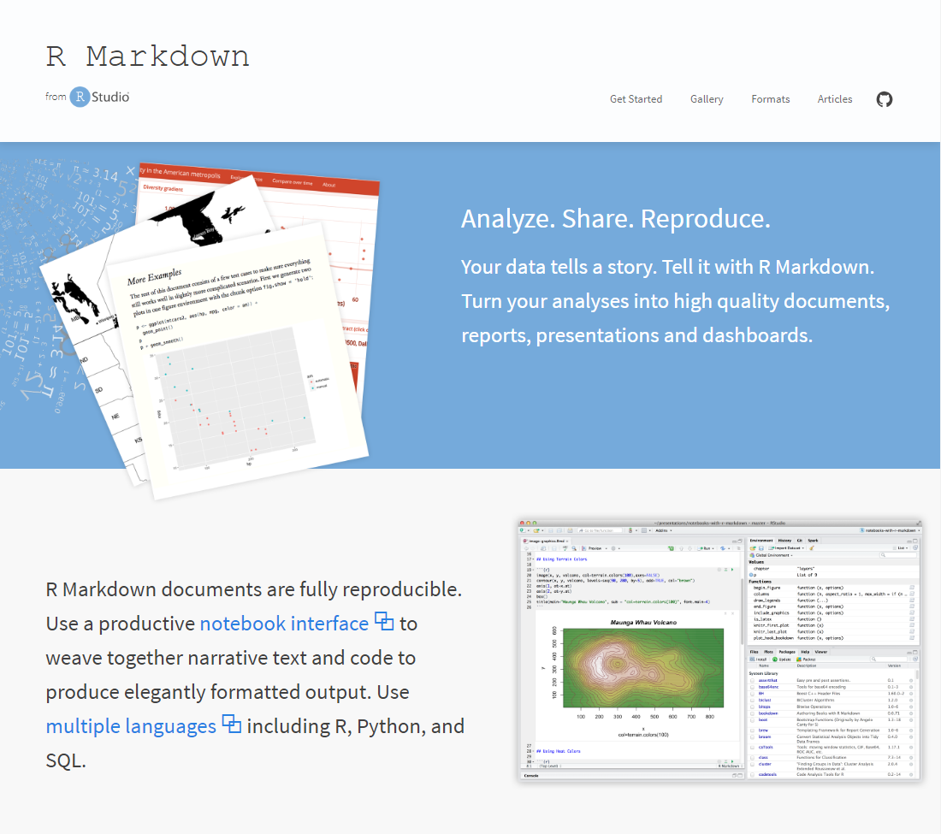
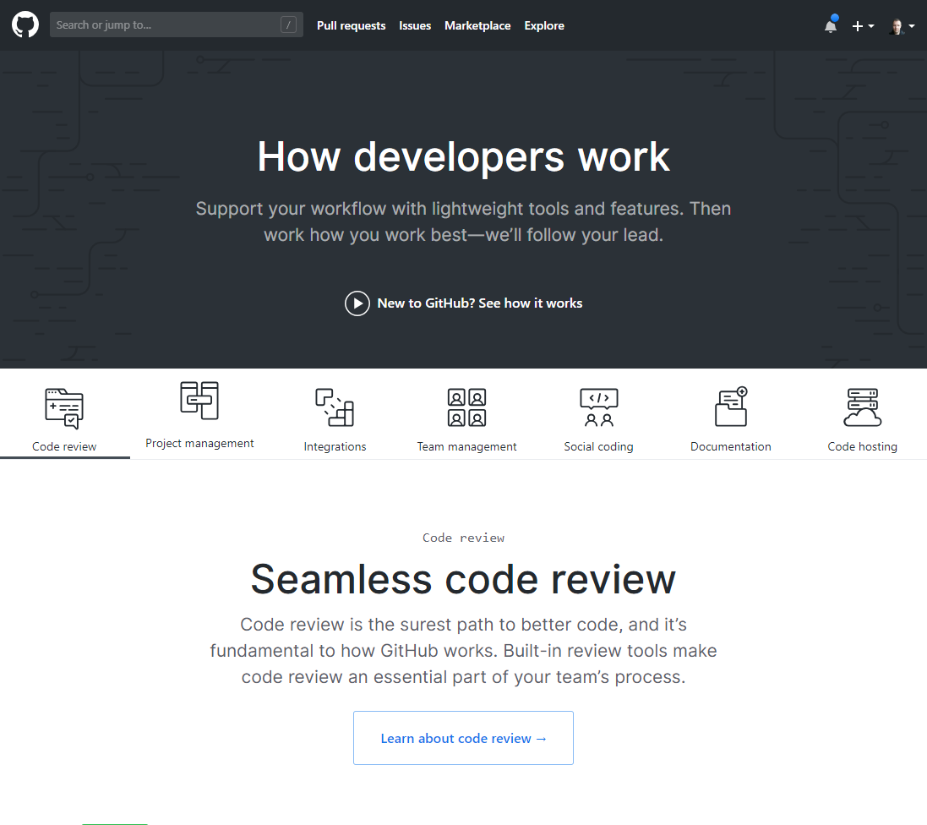
Conducting Reproducible Research…
How to we produce reproducible research?
Lots of different ways, but in Geographic Information / Spatial Data Science, two tools – RMarkdown and Github – are making openness and reproducibility far more straightforward

Slide 48
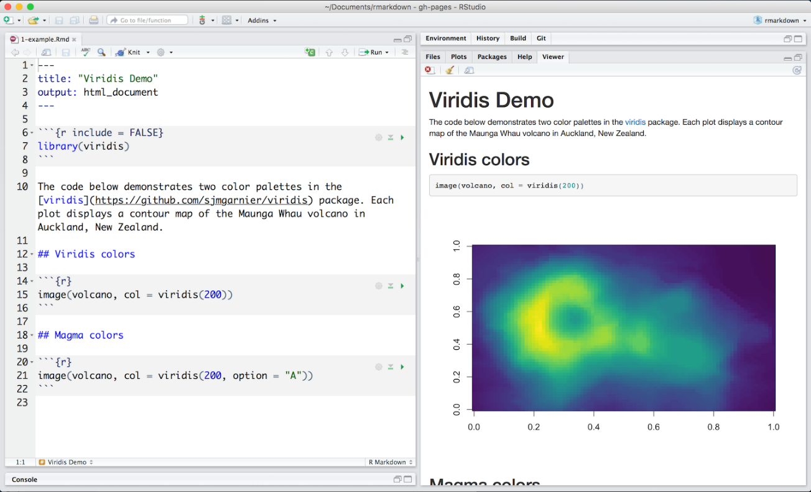
RMarkdown
RMarkdown documents enable the integration of text (commentary) with code and the outputs of that code.
RMarkdown documents can be ‘knitted’ into a range of different output formats
https://rmarkdown.rstudio.com/lesson-2.html

Slide 49
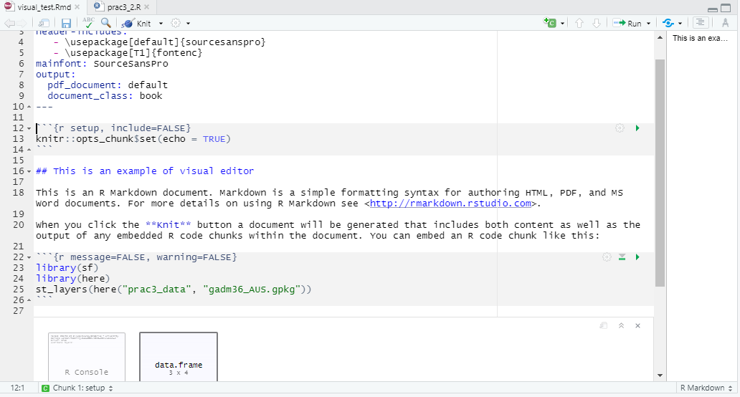
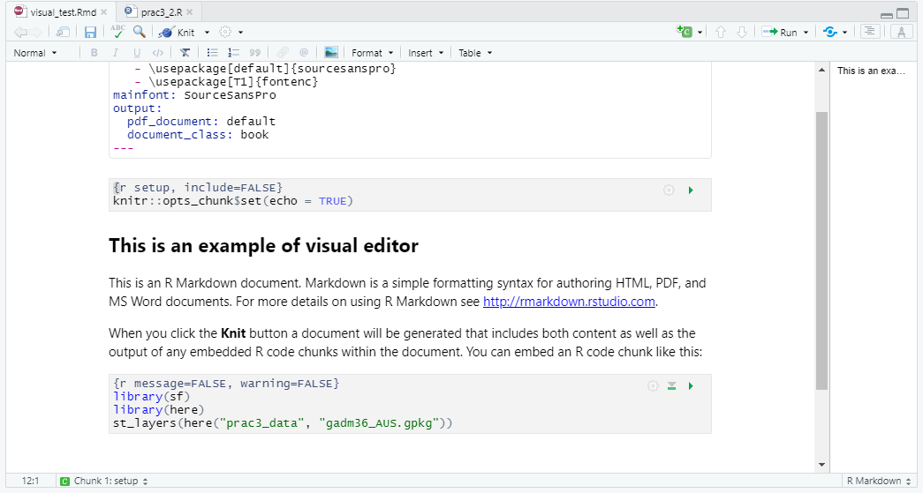
New Rmarkdown visual editor
With the recent release of version 1.4.9 there is a new visual RMarkdown feature
Basically moving towards a word style format with the option of code

Slide 50
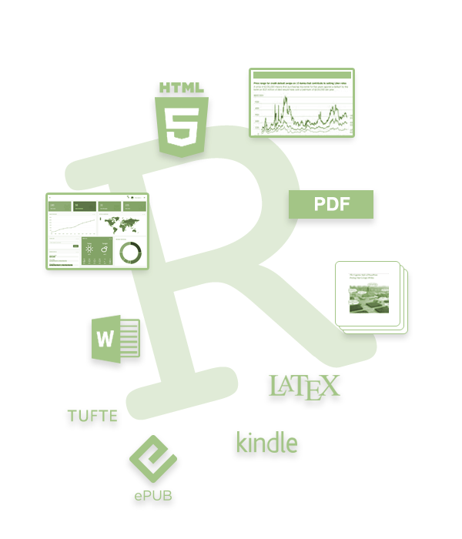
RMarkdown – Output Formats
HTML – Webpages
PDF documents
MS Word Documents
Books (see bookdown.org)
Scientific Papers formatted to particular journal styles
Slide-decks
Interpretive Dance*
*doesn’t actually output to interpretive dance - yet

Slide 51
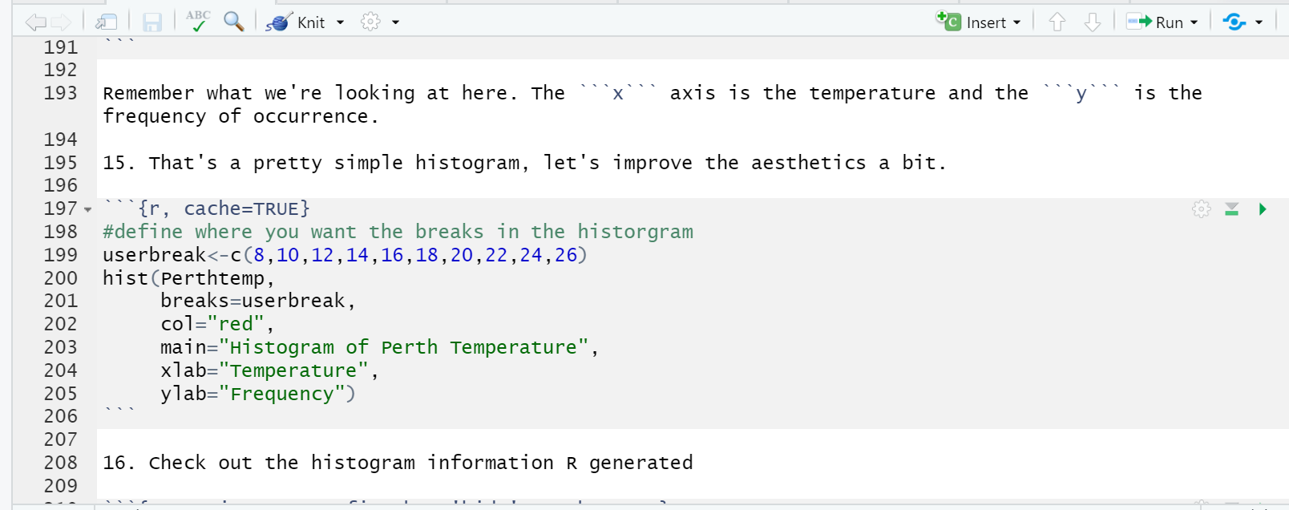
RMarkdown – Reproducibility Built In
Analysis and commentary are integrated so it is possible to describe the full workflow from data import > processing > analysis > results > interpretation/conclusions.
Anyone viewing your RMarkdown document will be able to reproduce exactly what you have done and through the commentary, understand how and why you have done it.

Slide 52
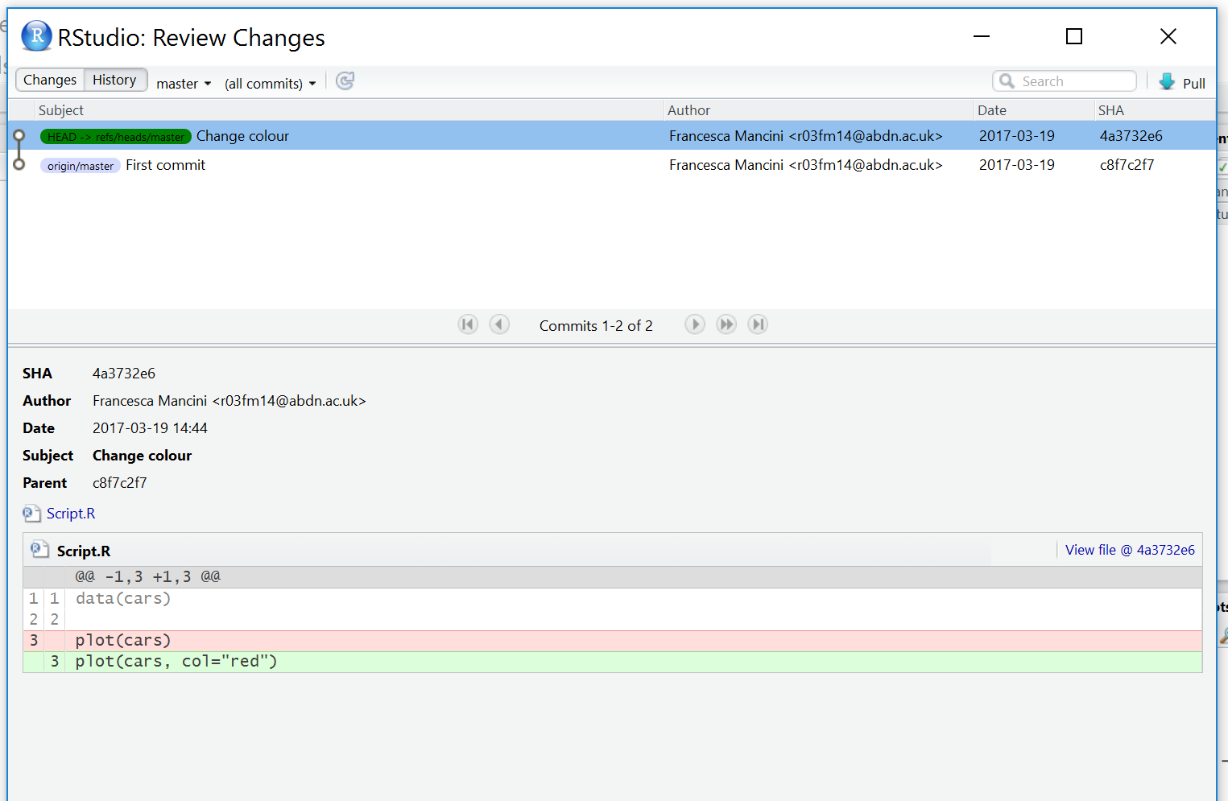
RMarkdown – Reproducibility Built In
It’s ASCII text so we can see the differences over time…

Slide 53



Terms
RStudio is a graphical user interface
RMarkdown is a version of the Markdown markup language which enables plain text to be formatted to contain links to data, code to run, text to explain what you a producing and metadata to tell your software what kinds of outputs to generate from your markdown code
Git is a software version control system which allows you to keep track of the code you produce and the changes that you or others make to it. It needs installing.
GitHub is an online repository that allows anyone to view the code you have produced (in whatever language you choose to program in) and use/scrutinise/contribute to/comment on it

Slide 54
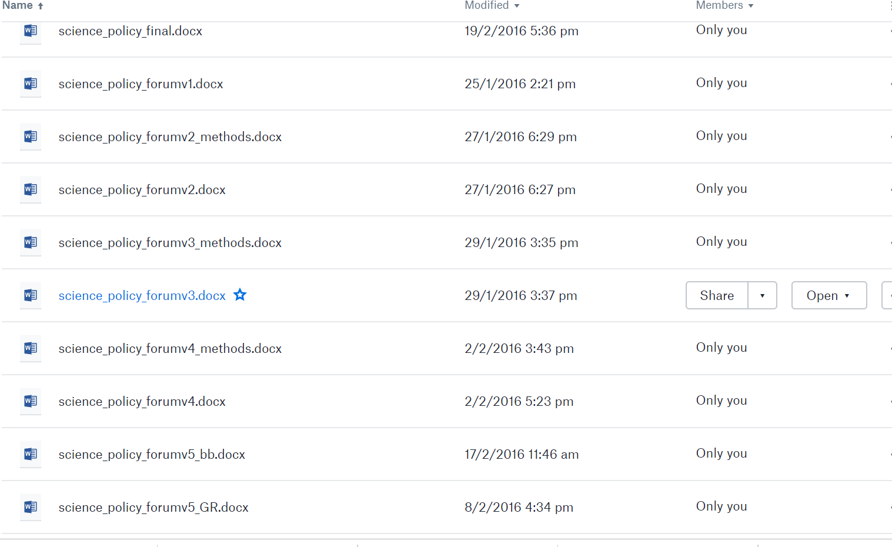
Git

Slide 55
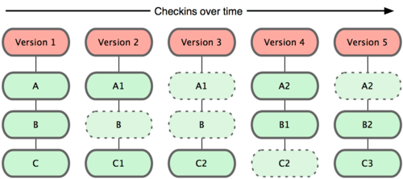
Git
A git repo = folder that tracks changes
You have three files A B and C
Git takes a snapshot every time you commit
If nothing changes it just uses the same one as before
It knows where the changes are

Slide 56
Git
Stage – prepare files to commit (checks for changes)
Commit – put them in my folder
Push – put them online…to GitHub

Slide 57
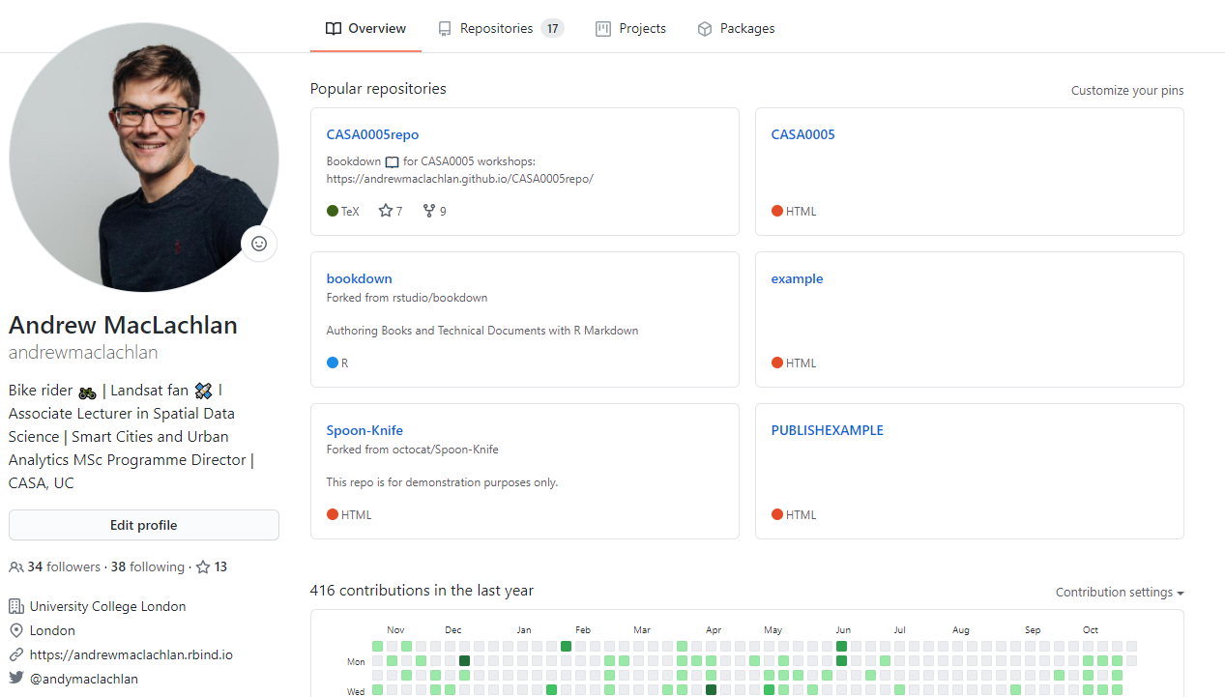
GitHub
An online hosting service for Git repositories

Slide 58
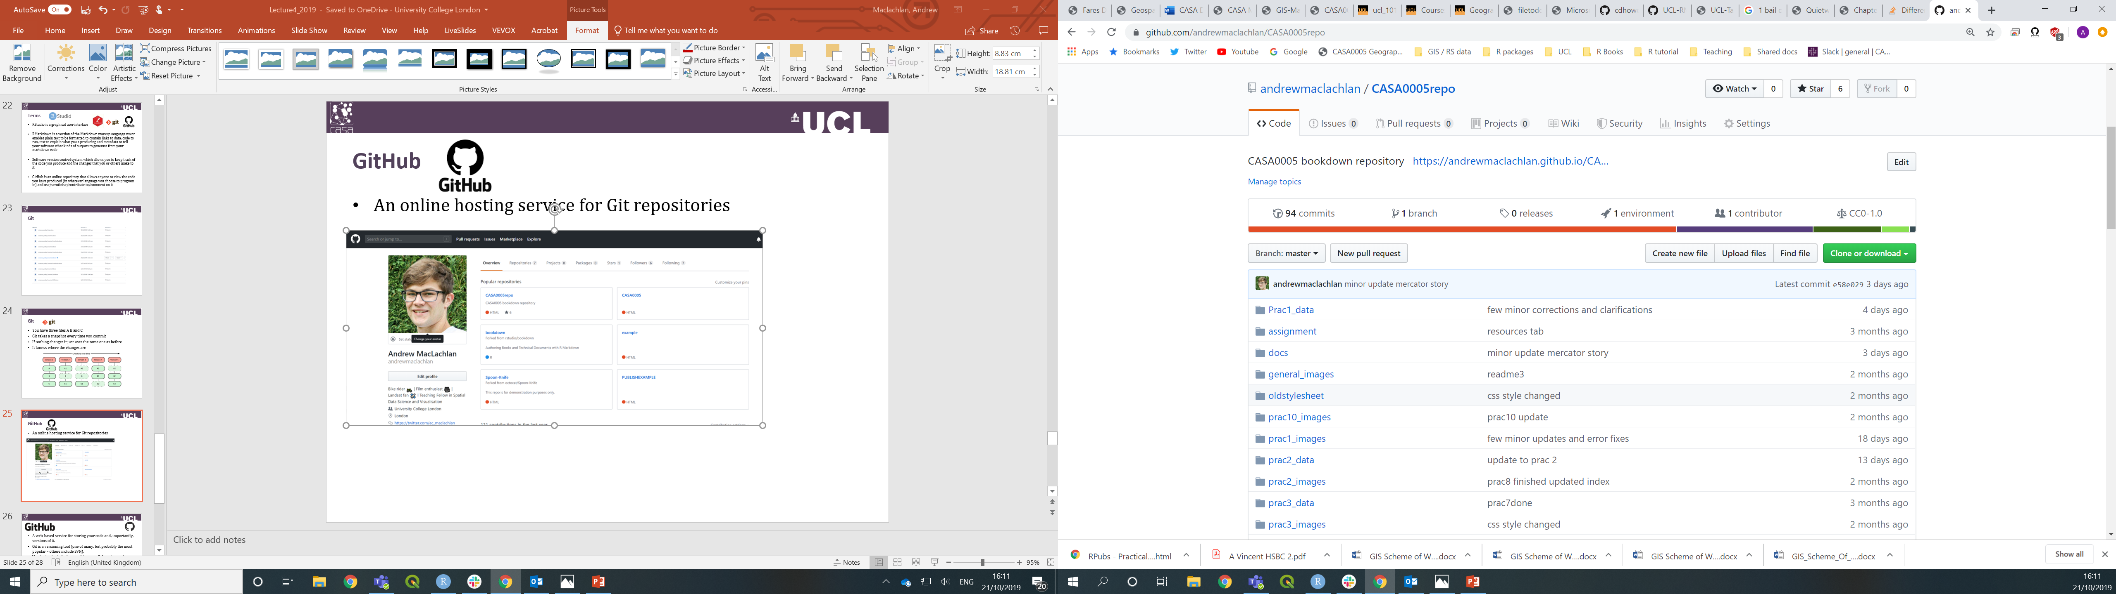
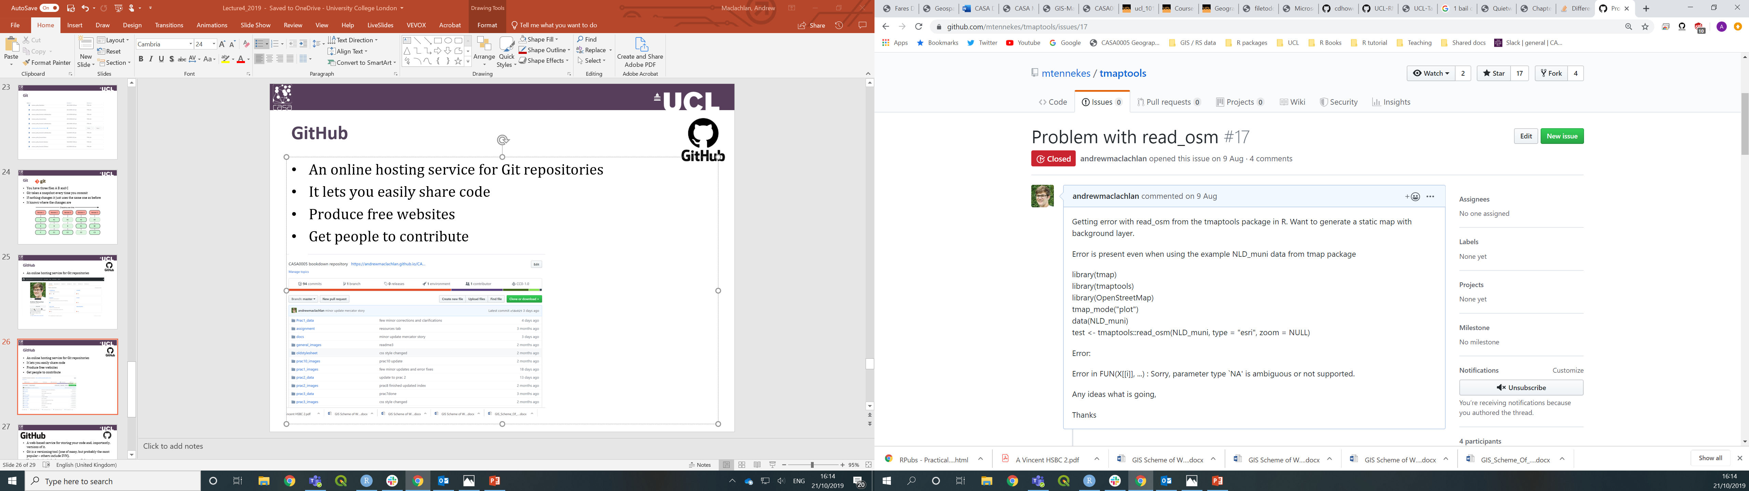
GitHub
An online hosting service for Git repositories
It lets you easily share code
Produce free websites
Get people to contribute and raise issues / improve code

Slide 59
Practical this week
This week’s practical will cover how to use:
Git – in R
GitHub – in R
RMarkdown
It’s important as we will use in the exam! It’s how you will submit your work
Before tomorrow watch Git for Humans by Alice Bartlett

